Slide 1

K. J. Somaiya Institute of Technology, Mumbai
Department of Computer Engineering A.Y. 2024-25
Major Project Proposals
LY-A Palak Desai – 10
Kapil Bhatia – 55
Dakshita Kolte – 65

Slide 2

Proposal 1
Problem Statement:
Smart Agritech : Digital Twin and AI for Sustainable Cotton Farming.
Tech Stack:
Language/Software: Python, ARCGIS / QGIS software.
Sensors: NPK, Ph, Temperature, Soil Moisture, Humidity.
Programming Language : Python

Slide 3
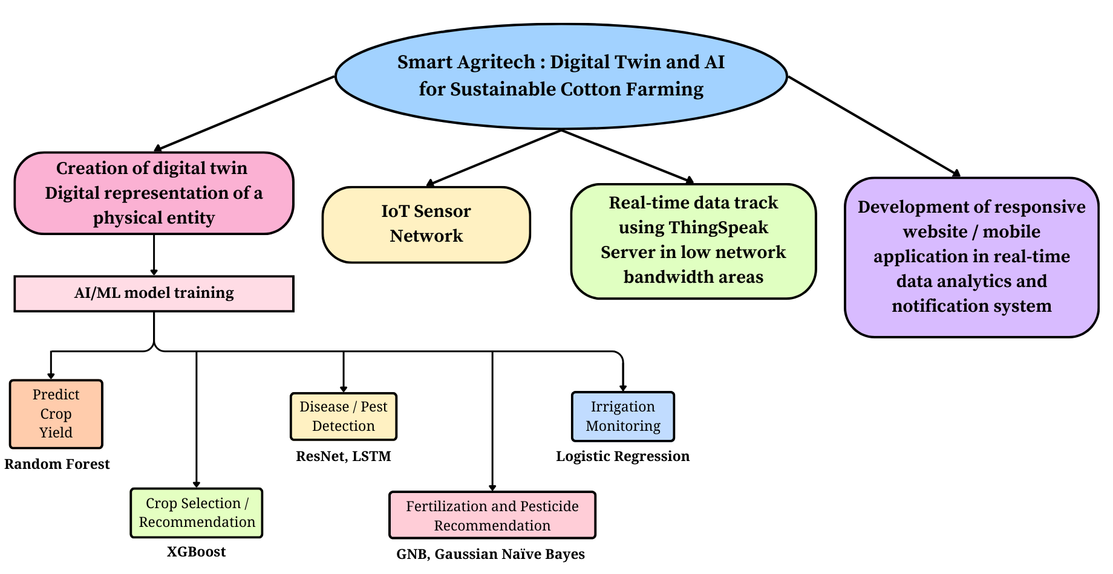
Proposed System

Slide 4
Proposal 2
Problem Statement:
Potential Impact of Land Use Land Cover (LULC) on Air Quality.
Tech Stack:
Language/Software: ARCGIS/QGIS
Programming Language: Python
Sample ARCGIS Dashboard link: https://www.arcgis.com/apps/dashboards/9e8a14308fb44a438d92b560dde7e133

Slide 5
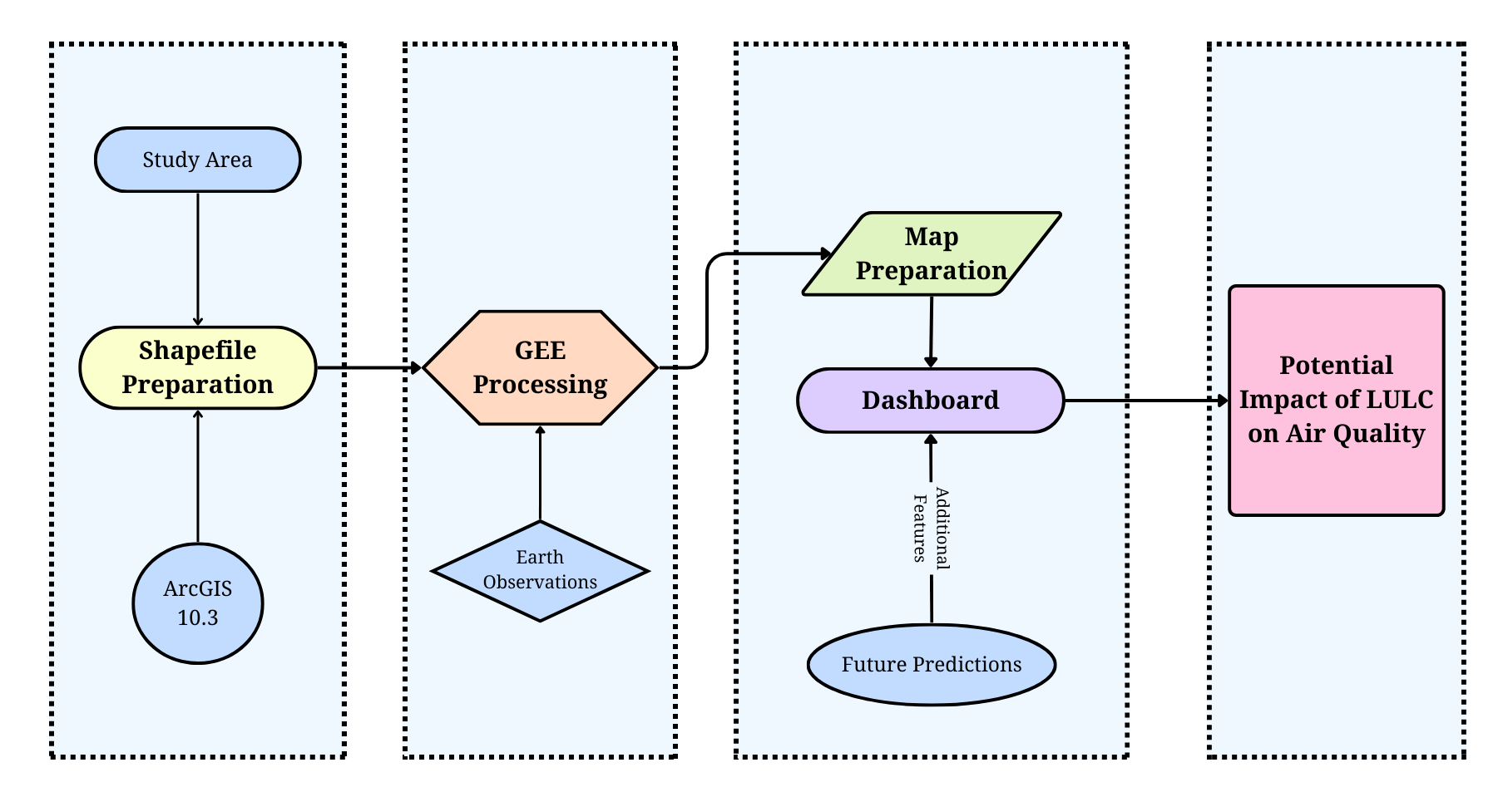
Proposed System

Slide 6
Proposal 3
Problem Statement:
Harnessing AI for Smart Cities: Optimizing Energy Consumption and Distribution in Smart Grids.
Tech Stack:
Software: MATLAB, Simulink
Programming Language: Python

Slide 7
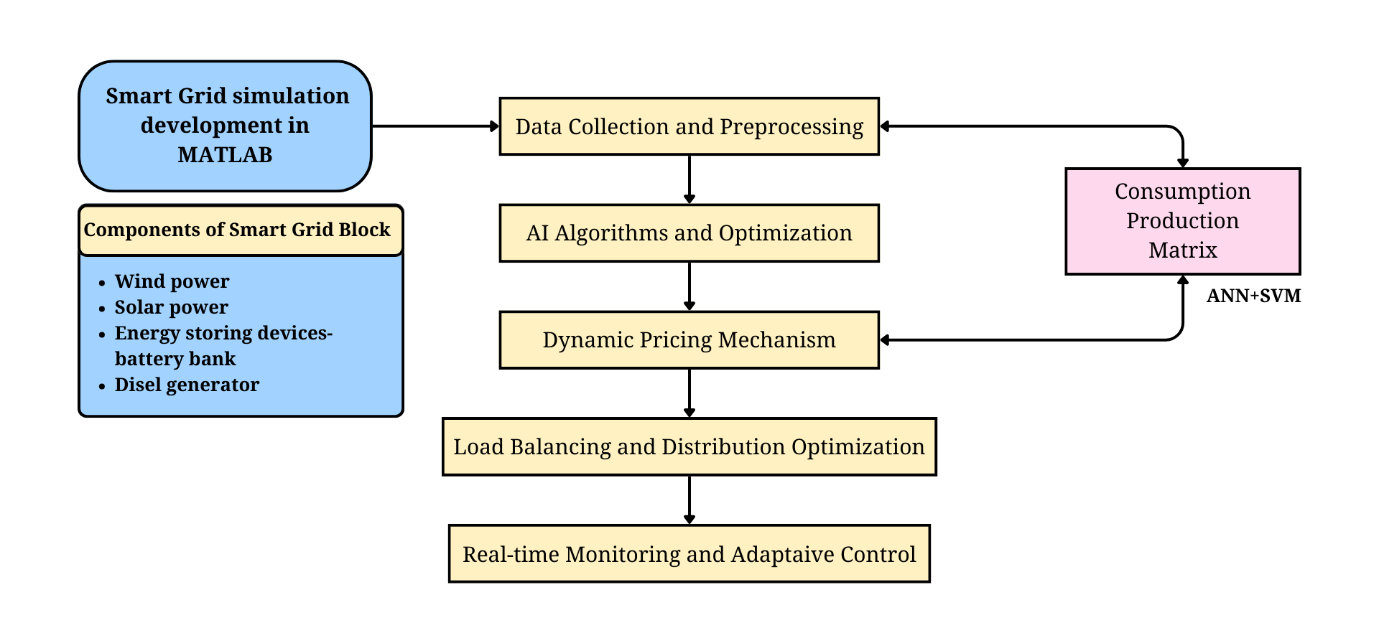
Proposed System

Slide 8
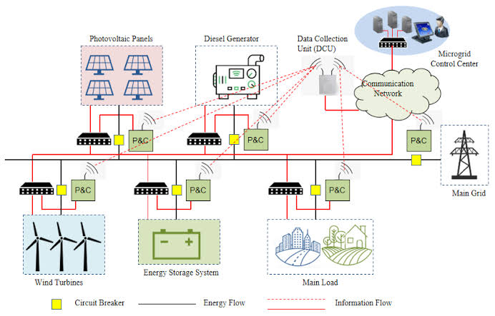
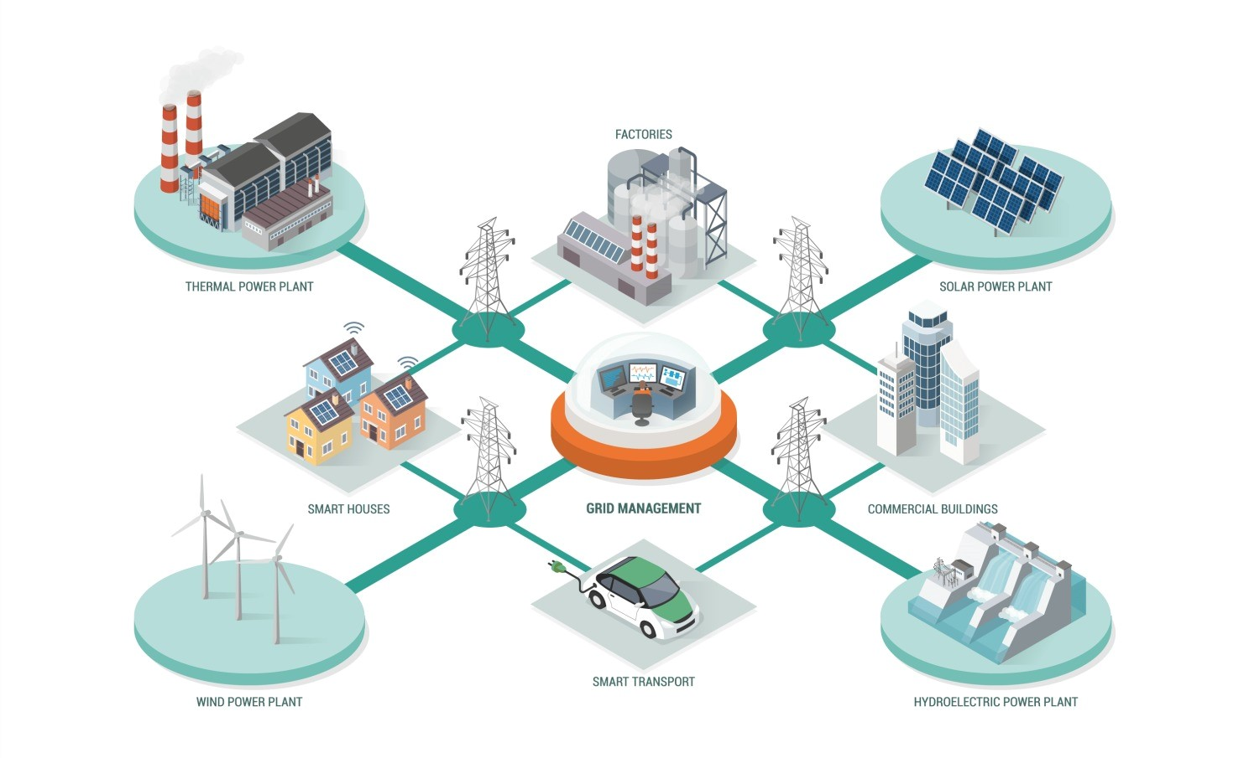
Smart Grid

Slide 9
THANK YOU!!!

